Slide 1
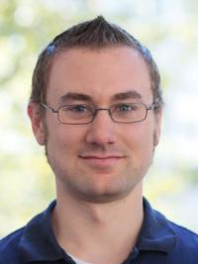
Mitosis - Transparently Self-Replicating Page-Tables for Large-Memory Machines
Reto Achermann¹
Ashish Panwar²
Abhishek Bhattacharjee³
Timothy Roscoe¹
Jayneel Gandhi⁴
¹ETH Zurich, ²IISc Bangalore, ³Yale University, ⁴VMware Research ASPLOS ‘20

Slide 2
Mitosis: Mitigate NUMA Effects on Page Table Walks
Up to 3.2x speed up for single threaded applications.
Up to 1.3x speed up on multi-threaded applications.
No modifications of the application workloads.
Measured on 4x12 Intel Xeon E7-4850 v3, with 512GB RAM (4x128GB)

Slide 3
NUMA Effects on Large Multi-Socket Machines
Bandwidth & capacity limited per processor socket
More bandwidth & capacity needed → Multi-socket machine
Non-uniform memory access (NUMA) machine
128 GB
128 GB
~279 cycles
~28 GB/s
Xeon E7 v3
Xeon E7 v3
~583 cycles
~11 GB/s
Xeon E7 v3
Xeon E7 v3
128 GB
128 GB
Measured on 4x12 Intel Xeon E7-4850 v3, with 512GB RAM (4x128GB)

Slide 4
Handling NUMA Effects on Data Pages
Goal: Keep process threads and data close
128 GB
Data
128 GB
Xeon E7 v3
Xeon E7 v3
Process
Process
Process
NUMA-aware
scheduling
NUMA-aware
data migration
Xeon E7 v3
Xeon E7 v3
Process
Data
Data
128 GB
Data
128 GB
Decades of work has focused on data placement.
What about placement of page tables?

Slide 5
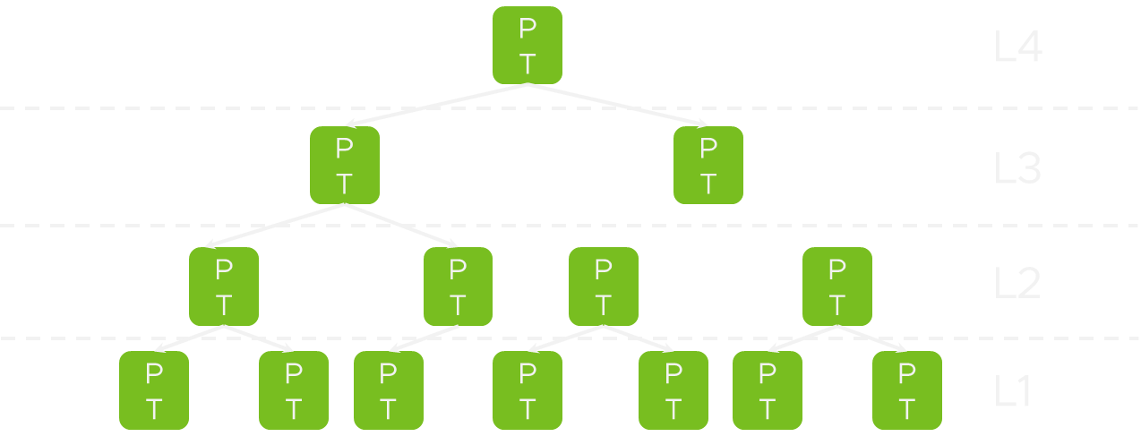
Every Memory Access Requires Virtual-to-Physical Translation
Background (x86 specific)
Processes deal with virtual addresses
0x40000
0x930 ​
47
12
11
0
Defined by the page table.
Multi-level radix-tree.
Virtual Page Number
Virtual Page Offset
On every memory access !
Translation
(MMU)
On every memory
access!
45
12
11
0
Physical Frame Number
Physical Frame Offset
0x2000
0x930 ​
0x2000930
RAM
memory knows physical addresses

Slide 6
Translation Lookaside Buffer
TLB misses trigger page table walks
Key Problem:
TLB coverage << available memory → more frequent TLB misses. Test machine with 512GB RAM, TLB coverage < 1% of memory
These TLB misses require multiple memory accesses
TLB
VA | PA | Perms
Virtual Address 0x40000930
TLB Hit (fast path)
TLB Miss (slow path)
47
39
38
30
29
21
20
12
11
0
0x0
0x1
0x0
0x0
0x930
Page Table Root Pointer
PML4
PDPT
PDIR
PT
Frame
Page table walk
Up to 4 additional memory accesses

Slide 7
NUMA effects on page table walks?

Slide 8
Study: Page Table Walks and NUMA
How often is the page table remote and what’s the resulting slowdown?
Distribution of page table entries
Local NUMA Node
Remote NUMA Node
Multi-Threaded Scenario

Slide 9
Many Threads – One Page Table
More workloads in the paper
Remote Memory Accesses are Inevitable
Majority of TLB misses require remote memory accesses
L3
L4
128 GB
128 GB
Xeon E7 v3
Xeon E7 v3
Process
Process
Xeon E7 v3
Xeon E7 v3
Process
Process
Process
128 GB
D
L1
128 GB
L2
Measured on Linux v4.17

Slide 10
Study: Page Table Walks and NUMA
How often is the page table remote and what’s the resulting slowdown?
Distribution of Page Table Entries
Local NUMA Node
Remote NUMA Node
Slow down due to remote memory accesses during page table walks
Multi-Threaded Scenario
Workload-Migration Scenario
Majority of TLB misses require remote memory accesses

Slide 11
Remote Page Walk Slow Down
More workloads in the paper
Data Migration Policy moves Data Pages, but not Page Tables
Up to 3.2x slowdown
128 GB
128 GB
Xeon E7 v3
Xeon E7 v3
Xeon E7 v3
Xeon E7 v3
Process
PT
D
128 GB
128 GB
PT
PT
PT
Data pages local,
page table remote.
Measured on Linux v4.17

Slide 12
Study: Page Table Walks and NUMA
How often is the page table remote and what’s the resulting slowdown?
Distribution of Page Table Entries
Local NUMA Node
Remote NUMA Node
Slow down due to remote memory accesses during page table walks
Multi-Threaded Scenario
Workload-Migration Scenario
Majority of TLB misses require remote memory accesses
Up to 3.2x slowdown

Slide 13
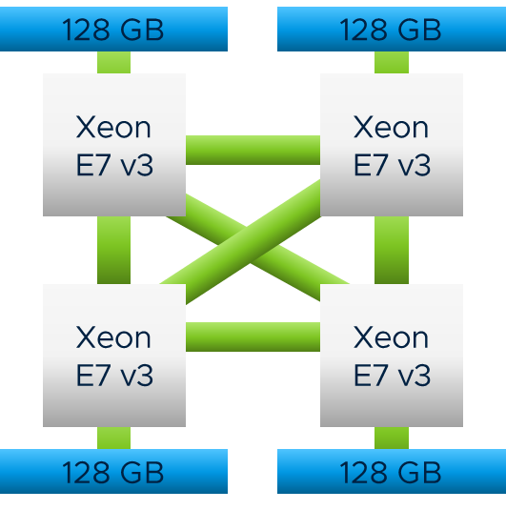
Mitosis: Transparent Replication and Migration for Page-Tables
Approach
Multi-Threaded Scenario
Workload-Migration Scenario
L4
L4
L3
L3
L2
L2
PT
PT
Process
Process
Process
Process
Process
L4
L4
L4
L3
L3
L3
L2
L2
L2
PT
PT
PT
Mitosis replicates the page table
Mitosis migrates the page table

Slide 14
Mitosis: Keep Page Tables Local using Replication and Migration.
Implementation on Linux / x86_64
Available on GitHub
https://github.com/mitosis-project

Slide 15
Mechanism: Replication of Page Tables
Replica Allocation
Consistent updates (Correctness)
Replica Utilization (Performance)

Slide 16
Allocation of Page-Table Replicas
Mitosis eagerly allocates memory for each page table replica.
Replica 1
Replica 2
PT
PT
PT
PT
PT
PT
PT
PT
PT
PT
PT
PT
PT
PT
PT
PT
PT
PT
PT
PT
PT
PT
PT
PT
PT
PT

Slide 17
Consistent Updates to Page-Table Replicas
Correctness
Mitosis eagerly keeps replicas consistent on update
Added pointers for circular linked list
Metadata for page 1
Metadata for page 2
Metadata for page 3
Metadata for page 4
Replica page 1
Replica page 2
Replica page 3
Replica page 4
PTE
PTE
PTE
PTE
Primary

Slide 18
Utilizing Page Table Replicas
Performance
Scheduler picks thread to run
Context switch
Select local replica
Write translation base register
Extend Linux’ mm_struct
with an array of page table roots
Indexed by NUMA node
mm->root[local_node()]

Slide 19
PV-Ops: Paravirtualization Operations in the Linux Kernel
Set page table entry
Allocate and free page table page.
Reading / writing translation base register
native bare metal environment set_pte() → native_set_pte()
paravirtualized environments set_pte() → xen_set_pte()
Mitosis implemented as PV-Ops backend.
Extends the native functions to propagate updates to replicas
Adding functions to read entries → access & dirty bits
PV-Ops Interface
Mitosis PV-Ops Backend

Slide 20
Consistency: Dealing with Access and Dirty Bits
Set by hardware and read by the OS
Bits set by hardware only in local replica → Inconsistency!
Correctness Problem: OS relies on those bits in paging / caching decisions
Solution: OR-ing entries of all replicas to determine dirty / accessed state!
if (pte_young(*ptep) || pte_dirty(*ptep)) {
// do something
}

Slide 21
Mitosis Policy Settings
procfs entries to globally enable/disable Mitosis
/proc/sys/kernel/pgtable_replication
Integration in numactl / libnuma
numactl –r 0-3 <workload>
System Wide Policy
Per Application Policy

Slide 22
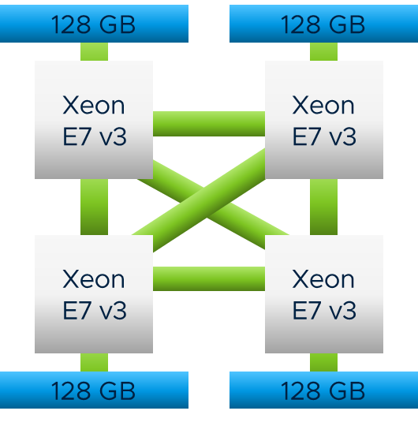
Results
Measured on
4x12 Intel Xeon E7-4850 v3,
with 512GB RAM (4x128GB)

Slide 23
Evaluation: Multi-Threaded Scenario with Mitosis
More workloads in the paper
PT
PT
PT
PT
PT
PT
PT
PT
PT
PT
128 GB
128 GB
Xeon E7 v3
Xeon E7 v3
Process
Process
Xeon E7 v3
Xeon E7 v3
Process
Process
PT
PT
PT
PT
128 GB
128 GB
PT
PT
PT
PT
PT
PT
First -Touch
Mitosis
Performance improvement with
replication of page tables

Slide 24
Evaluation: Workload-Migration Scenario with Mitosis
More workloads in the paper
128 GB
128 GB
Xeon E7 v3
Xeon E7 v3
3.2x
1.8x
Xeon E7 v3
Xeon E7 v3
Process
PT
128 GB
128 GB
PT
PT
PT
Performance improvement with
migration of page tables

Slide 25
Replica Maintenance Overhead
Mitosis with 4-Way Replication
mmap()
mprotect()
munmap()
Runtime Overhead
Space Overhead: 0.6% of additional memory for 4-way replication

Slide 26
Mitosis Summary
Available on GitHub
https://github.com/mitosis-project
Click to edit optional subtitle
Mitosis mitigates NUMA effects on page table walks
NUMA effects
Mitosis Linux Implementation
Results
The first study to show NUMA effects on page table walks.
Page table replication as PV-Ops backend.
Integration into libnuma and numactl.
3.2x speed up for workload migration scenario
Up to 1.3x speed up for multi-socket scenario .

