Slide 1
Fast Local Page-Tables for Virtualized
NUMA Servers with vMitosis
Ashish
Panwar¹
Reto
Achermann²
Arkaprava Basu¹
Abhishek Bhattacharjee³
Kanchi
Gopinath¹
Jayneel
Gandhi⁴
¹ Indian Institute of Science ²University of British Columbia ³ Yale University ⁴ VMware Research
Architectural Support for Programming Languages and Operating Systems 2021 (ASPLOS’21)

Slide 2
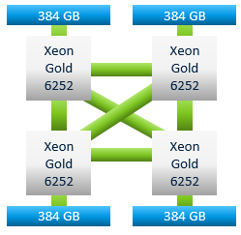
Overview
Virtualization + NUMA
Two-dimensional page-tables
Variable memory access latency
vMitosis
Mitigating NUMA effect on page-table walks
Challenges and solutions
Results
Up to 3.1x speed up for single-socket workloads
Up to 1.6x speed up for multi-socket workloads

Slide 3
Virtualized address translation
1
guest physical
address
2
host physical
address
guest virtual
address
gVA
gPA
hPA
guest page-table
(gPT)
extended page-table
(ePT)
Performance implication
NUMA exacerbates
address translation overhead (Mitosis – ASPLOS’20)
vMitosis
Up to 24 memory references
10-50% runtime overhead
Virtualizing Mitosis
Challenges and solutions

Slide 4
NUMA effect on virtualized address translation
Scenario 1: VM/workload migration
Existing NUMA optimizations target only user-level data
Page size: 4KiB
384 GB
384 GB
Xeon Gold 6252
Xeon Gold 6252
3.1x
2x
2.4x
2.3x
Xeon Gold 6252
Xeon Gold 6252
Threads
384 GB
D
gPT
ePT
384 GB
remote
page-tables are pinned!
4
4

Slide 5
NUMA effect on virtualized address translation
Scenario 2: multi-socket workloads
Many threads, multiple sockets – one page-table
D
D
384 GB
384 GB
Xeon Gold 6252
Xeon Gold 6252
Threads
Threads
Xeon Gold 6252
Xeon Gold 6252
Threads
Threads
D
D
gPT
ePT
384 GB
384 GB
5
5

Slide 6
Virtualizing NUMA machines
Configurations
NUMA-visible VM
NUMA-oblivious VM
Guest applications
Guest applications
Virtual machine
Guest OS (Linux)
Virtual machine
Guest OS (Linux)
vCPUs
DRAM
vCPUs
DRAM
vCPUs
DRAM
Hypervisor
Hypervisor
Host
Host
CPU
DRAM
CPU
DRAM
CPU
DRAM
CPU
DRAM
socket 0
socket 1
socket 0
socket 1

Slide 7
NUMA effect on virtualized address translation
Scenario 2: multi-socket workloads
Workload: graph500
NUMA-visible VM
NUMA-oblivious VM
Majority of page-table walks involve remote memory accesses
7
7

Slide 8
vMitosis: Making two-dimensional page-tables local
Techniques
VM/workload migration
Multi-socket workloads
D
gPT³
ePT³
D
gPT²
ePT²
384 GB
384 GB
384 GB
384 GB
Xeon Gold 6252
Xeon Gold 6252
Xeon Gold 6252
Xeon Gold 6252
Threads
Threads
Xeon Gold 6252
Xeon Gold 6252
Xeon Gold 6252
Xeon Gold 6252
Threads
Threads
Threads
384 GB
D
gPT
ePT
D
gPT⁴
ePT⁴
D
gPT
ePT
384 GB
384 GB
384 GB

Slide 9
vMitosis: Migrating page-tables
Policy: Placing page-table pages with majority of their children
page-table page
per-socket counters
0 1 2 3
0
0
0
0
3
3
2
2
1
1
1
1
2
Ideal placement: socket-1
socket 0
socket 1
socket 2
socket 3

Slide 10
vMitosis: Migrating page-tables
Migration in action
L1
L1
L2
L2
L2
D
ePT
L2
384 GB
384 GB
L3
L3
L3
L3
L3
L3
Xeon Gold 6252
Xeon Gold 6252
L3
L3
Threads
L4
L4
L4
L4
L4
L4
L4
L4
L4
L4
L4
L4
L4
L4
L4
L4
Xeon Gold 6252
Xeon Gold 6252
ePT
384 GB
384 GB

Slide 11
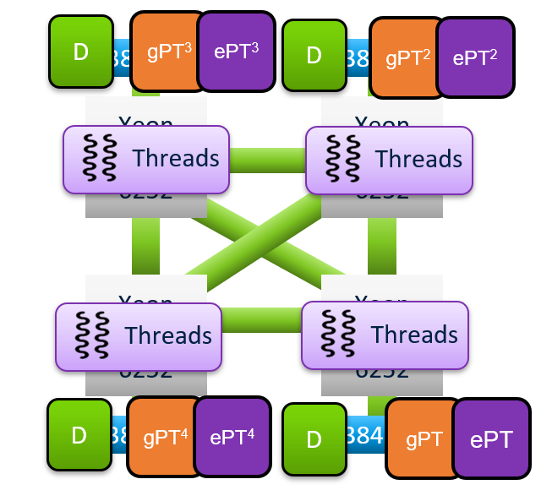
vMitosis: Replicating page-tables
Design components
Allocating gPT and ePT replicas
Scheduling threads and vCPUs with local ePT/gPT
Ensuring translation coherence
Preserving access and dirty bit semantics
Ensuring translation coherence
Access/dirty bit semantics
Propagate ePT/gPT updates to all replicas
Eager policy
OR values from all replicas while reading
Clear all replicas while writing

Slide 12
vMitosis: Replicating page-tables
NUMA-visible virtual machines
Guest application
Threads
Threads
Virtual
machine
Guest OS (Linux)
gPT
vCPUs
gPT²
vCPUs
DRAM
DRAM
Hypervisor
Host
ePT²
CPU
ePT
DRAM
DRAM
CPU
socket-0
Socket-1

Slide 13
vMitosis: Replicating guest page-tables
NUMA-oblivious virtual machines
vCPU-0
vCPU-2
vCPU-4
vCPU-6
Requirements:
Identifying NUMA mappings of vCPUs
Allocating gPT replicas
vCPU to replica assignment
vCPU-1
vCPU-3
vCPU-5
vCPU-7
NUMA-oblivious resources
P0
P1
P2
P3
P4
P5
P6
P7
Identifying NUMA mappings
Allocating gPT replicas
Exploiting hardware characteristics
Core-to-core communication latency
Exploiting software behavior
Demand paging and “local” allocation

Slide 14
Identifying vCPU NUMA mappings
Microbenchmark
write to a shared variable ➔ cache-line bouncing
384 GB
384 GB
vCPU2
vCPU0
Xeon Gold 6252
Xeon Gold 6252
vCPU1
Measurements
Intra-socket: ≈ 50-55ns
Inter-socket: ≈ 125-130ns
Xeon Gold 6252
Xeon Gold 6252
vCPU3
384 GB
384 GB

Slide 15
Identifying vCPU NUMA mappings
Constructing virtual NUMA groups
vCPU-0
vCPU-2
vCPU-4
vCPU-6
0
0 1 2 3 4 5 6 7
1
- 125 125 125 50 125 125 125
vCPU-1
vCPU-3
vCPU-5
vCPU-7
2
- - 125 125 125 50 125 125
NUMA-oblivious resources
3
- - - 125 125 125 50 125
- - - - 125 125 125 50
P0
P1
P2
P3
P4
P5
P6
P7
vNUMA-0
vCPU-0
vCPU-4
vNUMA-1
vCPU-1
vCPU-5
vNUMA-2
vCPU-2
vCPU-6
vNUMA-3
vCPU-3
vCPU-7

Slide 16
Allocating gPT replicas
Enabling local page-table walks
vNUMA-0
vNUMA-1
vNUMA-2
vNUMA-3
vCPU-0
vCPU-1
vCPU-2
vCPU-3
Virtual
machine
vCPU-4
vCPU-5
vCPU-6
vCPU-4
vCPU-6
vCPU-7
vCPU-5
vCPU-7
P0
P1
P0
P7
P2
P4
P6
P7
P3
P4
P3
P5
“local” page allocation
ePT violation
Hypervisor
CPU
DRAM
CPU
DRAM
CPU
DRAM
CPU
DRAM
socket-0
socket-1
socket-2
socket-3

Slide 17
Results
Page-table migration
Page size: 4KiB
Page size: 2MiB (THP)
3.1x
2.4x
2.3x
2x
1.02x
out-of-memory
1.47x
1.35x

Slide 18
Results
Page-table replication
Page size: 4KiB
Page size: 2MiB (THP)
1.2x
1.3x
1.12x
1.6x
1.27x
out-of-memory

Slide 19
Available on GitHub
https://github.com/mitosis-project
vMitosis in a nutshell
Observations
Contributions
Results
NUMA exacerbates virtualized address translation overhead
Existing NUMA optimizations
ignore kernel objects
Analysis of page-table walk access locality
Replication and migration of two-
dimensional page-tables
Prototype implementation in Linux and KVM
1.06 - 1.6x speed up for
multi-socket workloads
1.8 - 3.1x speed up for
single-socket workloads
1.0 – 1.47x speed up over THP
More details in the paper!

